Slide 1

MS SQL Server
Course Introduction
SoftUni Team
Technical Trainers
Software University
https://softuni.bg/

Slide 2
Table of Contents
Course Objectives
Training and Team
Course Organization
Course Infrastructure
Evaluation Criteria
2

Slide 3
Have a Question?
sli.do
#csharp-db

Slide 4










SoftUni Diamond Partners

Slide 5



Educational Partners

Slide 6

Course Objectives

Slide 7
C# Database Fundamentals Module Goals
Basic Database and Query Concepts
Content: SQL syntax, Data types, Programmability
ADO.NET Library
ORM Fundamentals
Entity Framework Core
Automapper Library and
Best Practices and Architecture
Workshop - ASP.NET core
7

Slide 8
Course Objectives
DB Intro, Data Definition and Data Types
Basic CRUD, Intro to SQL
Built-in functions with T-SQL
Data Aggregation
Table Relationships
Subqueries and Joins
Database Programmability
8

Slide 9
Practical Programming Exam
12 practical problems for 4 hours
DDL
DML
Querying
Programmability
Automated judge system
http://judge.softuni.bg
Solutions are evaluated for correctness only
Code quality is still not measured
9

Slide 10
Theoretical Exam
You will have 30 minutes once you enter
English
Automated quiz system
Available during the practical exam and 30 minutes after it
You can submit your answers just one time
10

Slide 11

The Team

Slide 12

Stamo Petkov
Head Of Department at Information Services Plc.
Worked with various technologies
.NET and C#, BASIC, Pascal, Object Pascal, PHP
More than 15 years of experience
Experienced Lecturer
C# Basics and ASP.NET MVC @ Softuni

Slide 13
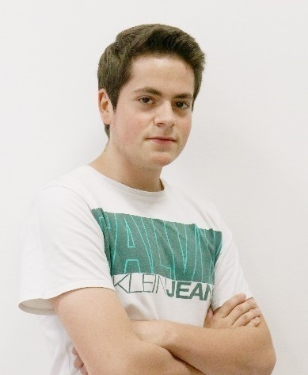
Kristiyan Ivanov
Top Student @ SoftUni
Technical Trainer @ SoftUni
Student @ Technical University of Sofia
Interests include mechanics and electronics
Automotive Software Development
Interested in coding with C#, Python, C++

Slide 14

Course Organization

Slide 15
C# Database Fundamentals Module – Timeline
13-Sep-2021
16-Oct-2020
18-Oct-2021
16-Dec-2021
MSSQL
5 weeks * 4 times / week
9 credits
Start: 13-Sep-2021
Exam: 16-Oct-2021
Retake exam: 10-Dec-2021
Entity Framework Core
7 weeks * 4 times / week
15 credits
Start: 18-Oct-2021
Final exam: 04-Dec-2021
Retake exam: 16-Dec-2021

Slide 16

Homework Assignments & Exercises
Your homework is mainly work in class
Lesson days → slides + live demos + exercises
Exercise days → only exercises
How to submit your homework?
Submitted in the judge system
Do your homework when it's due
Assignments pile up quickly

Slide 17


SoftUni Certificate
Practical Exam 100%
Homework 5%
Evaluation
17

Slide 18
CPE Certificate
Practical Exam
Theoretical Exam
Evaluation
18

Slide 19



Course Web Site, Forum and FB Group
Official web site:
Official discussion forum:
Official Facebook group:
https://softuni.bg/trainings/3491/ms-sql-September-2021
https://softuni.bg/forum/categories/63/module-csharp-db
https://www.facebook.com/groups/CsharpDBSeptember2021

Slide 20
Questions?
Notes:
20

Slide 21
Trainings @ Software University (SoftUni)
Software University – High-Quality Education, Profession and Job for Software Developers
softuni.bg, about.softuni.bg
Software University Foundation
softuni.foundation
Software University @ Facebook
facebook.com/SoftwareUniversity
Software University Forums
forum.softuni.bg
21
Notes:
21

Slide 22

License
This course (slides, examples, demos, exercises, homework, documents, videos and other assets) is copyrighted content
Unauthorized copy, reproduction or use is illegal
© SoftUni – https://about.softuni.bg
© Software University – https://softuni.bg
Notes:
22

